Slide 1
Cars4You

Slide 2
Introduction
Objective:
To make an app that would recommend used cars to users based on their preference
Why?
Instant real time recommendations
Discovery – Different perspective and cars

Slide 3
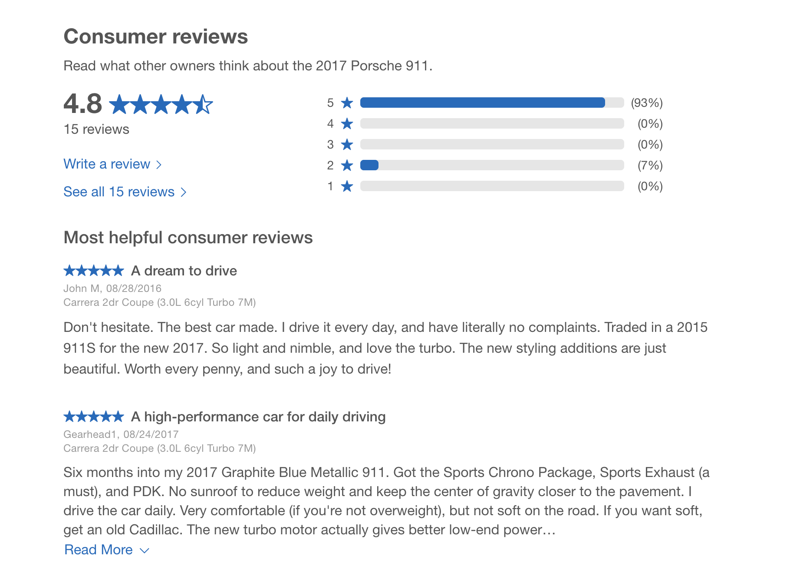
You can also split your content
Data
Edmunds.com
Car Title
Consumer Reviews
Consumer Ratings

Slide 4
Our process is easy
Methodology
(2) Receive Recommendations
(1) User Input
Cars4You
User Input Pre-Processing
Edmund Car Reviews
Data Pre-Processing
Recommendations
LDA Topic Modeling

Slide 5
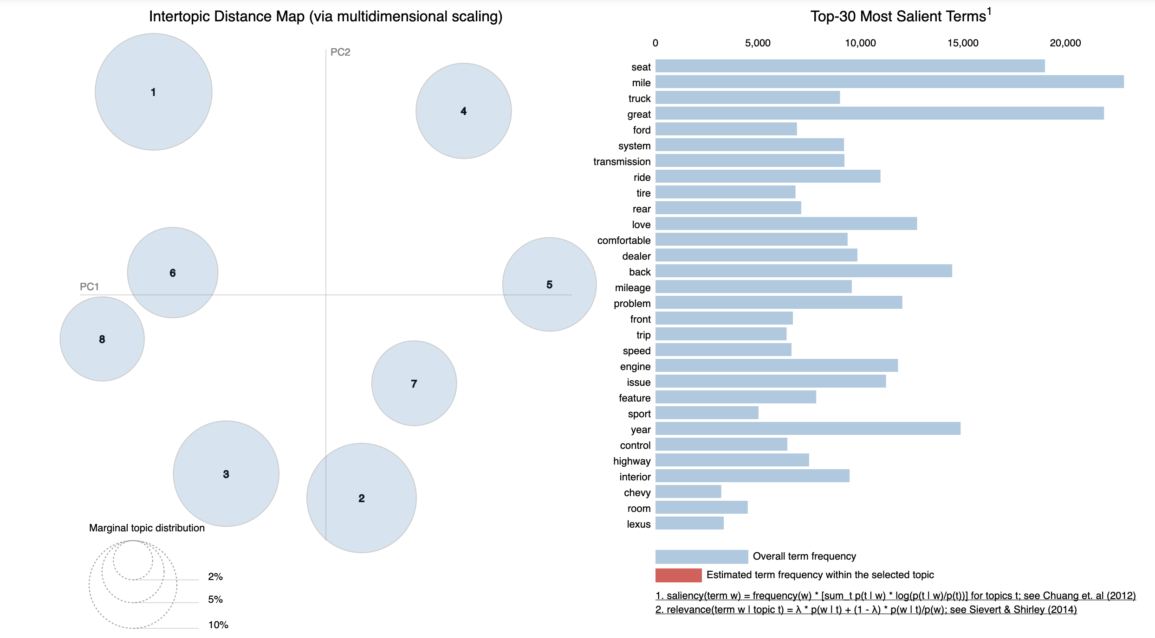
pyLDA Visualization

Slide 6
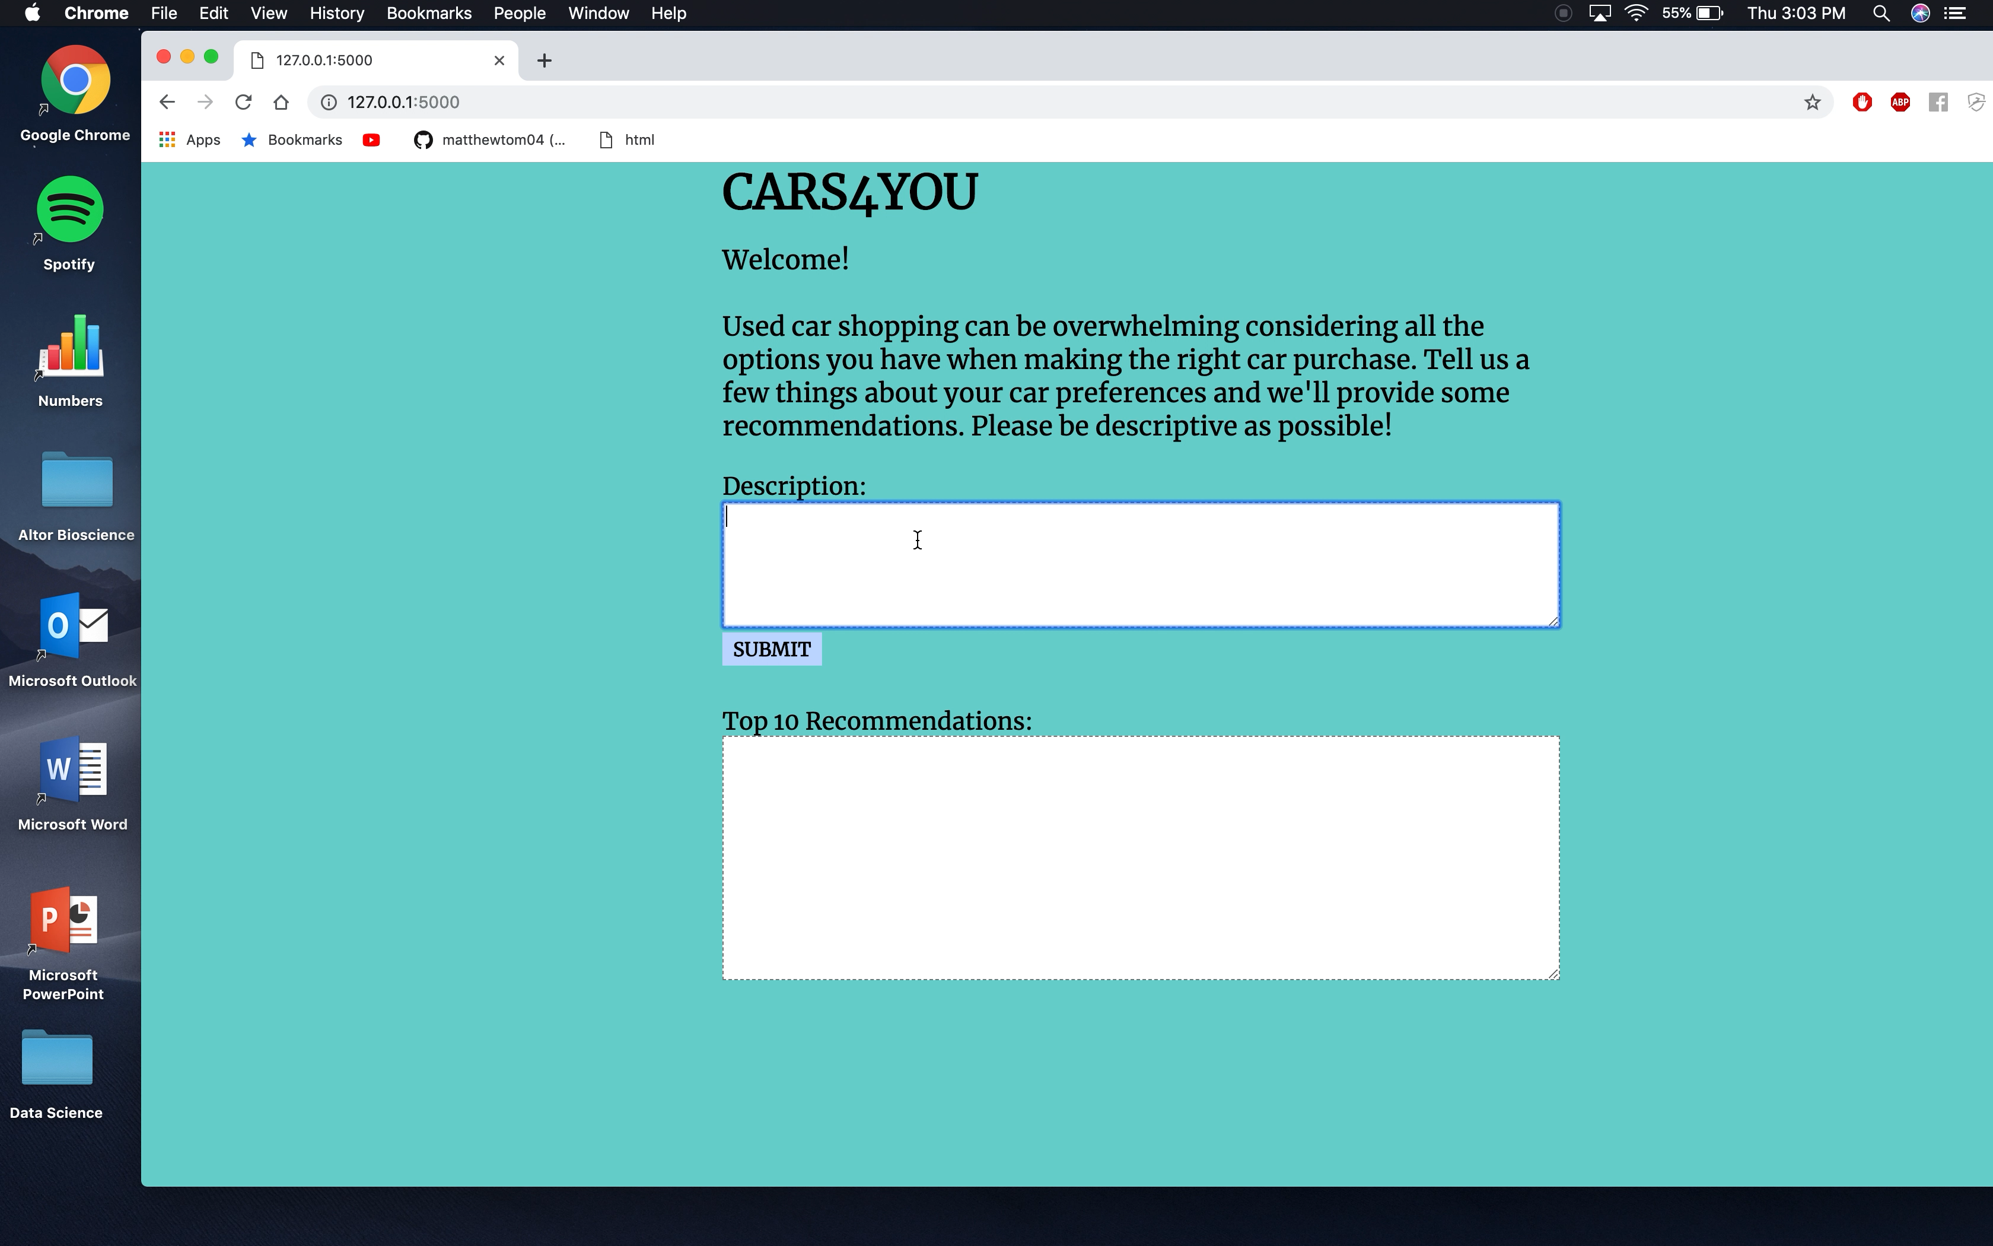
Flask App Deployment

Slide 7
You can also split your content
Conclusion
Limitations
Misspellings and slang get strange answers
Future Work
LDA2Vec
More consumer reviews

Slide 8
Thanks!
ANY QUESTIONS?

Slide 9
Our process is easy
LDA Topic Modeling

Slide 10
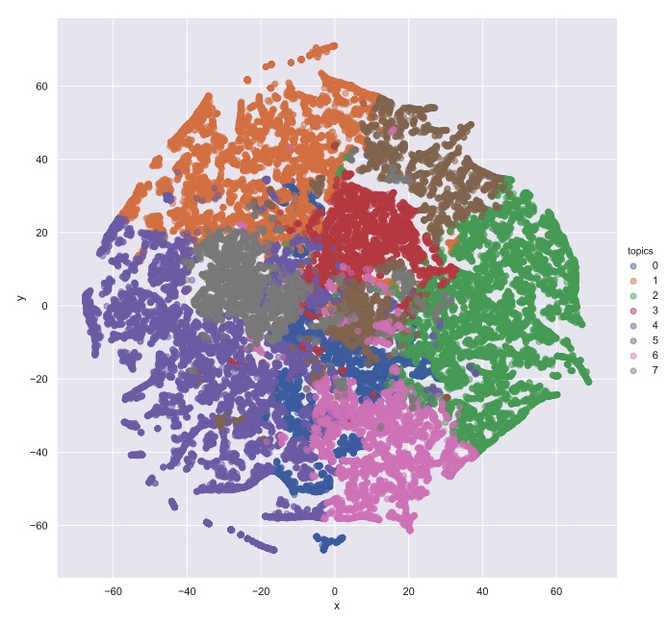

Slide 11
LDA Topic Selection

